Slide 1
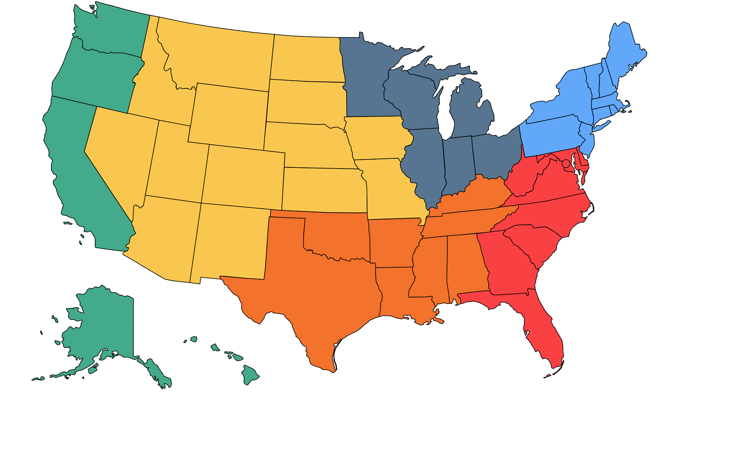
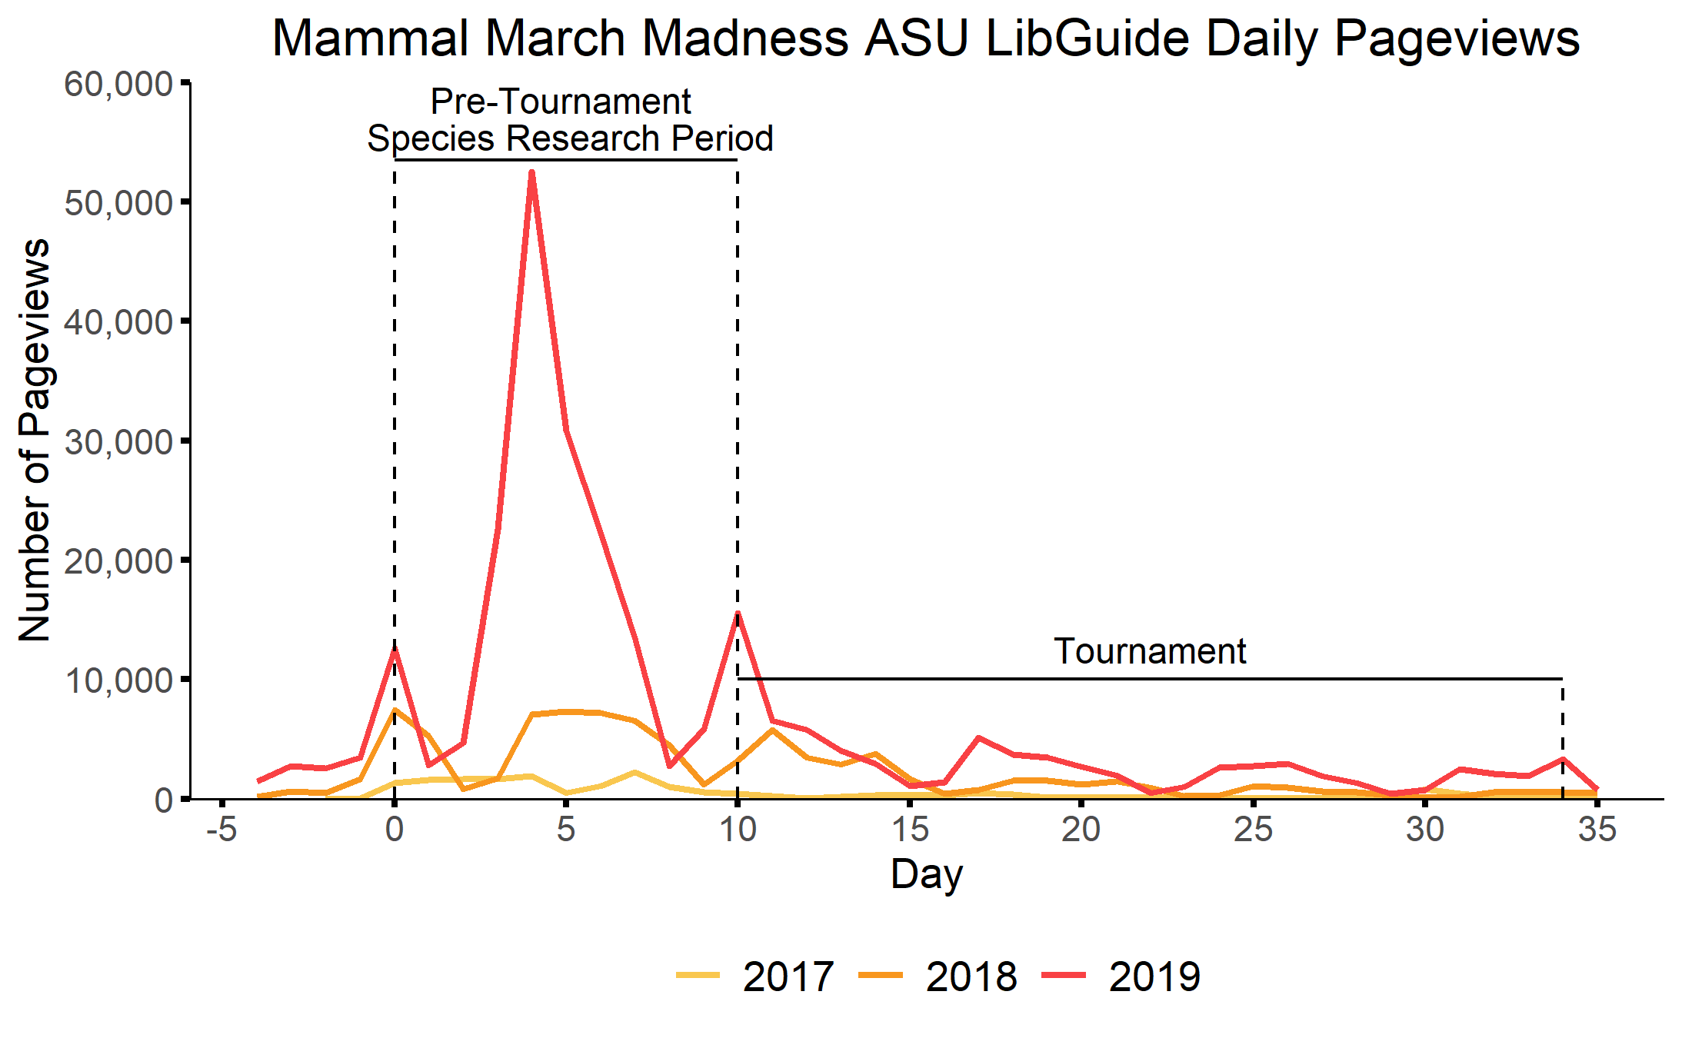
Bracket Drop

Slide 3
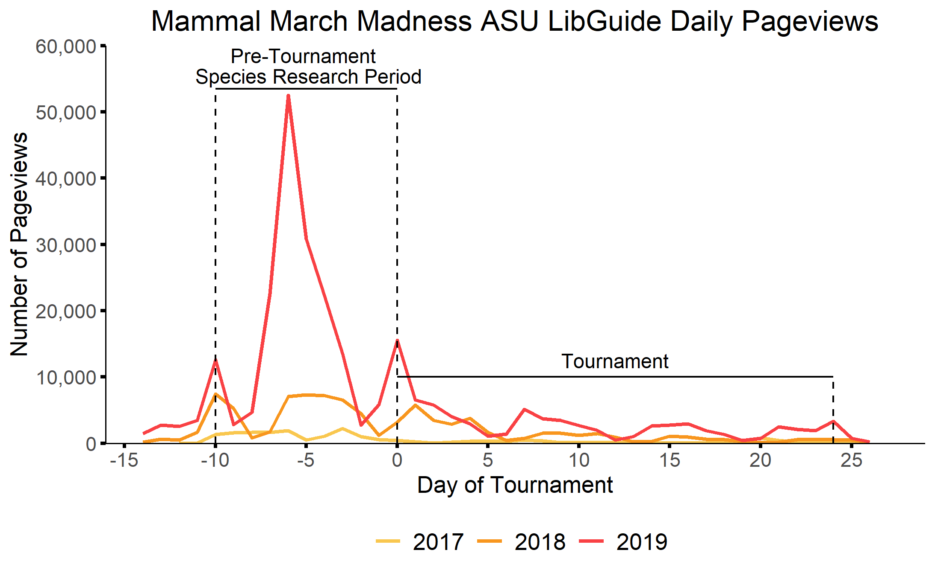
Bracket Drop

Slide 4
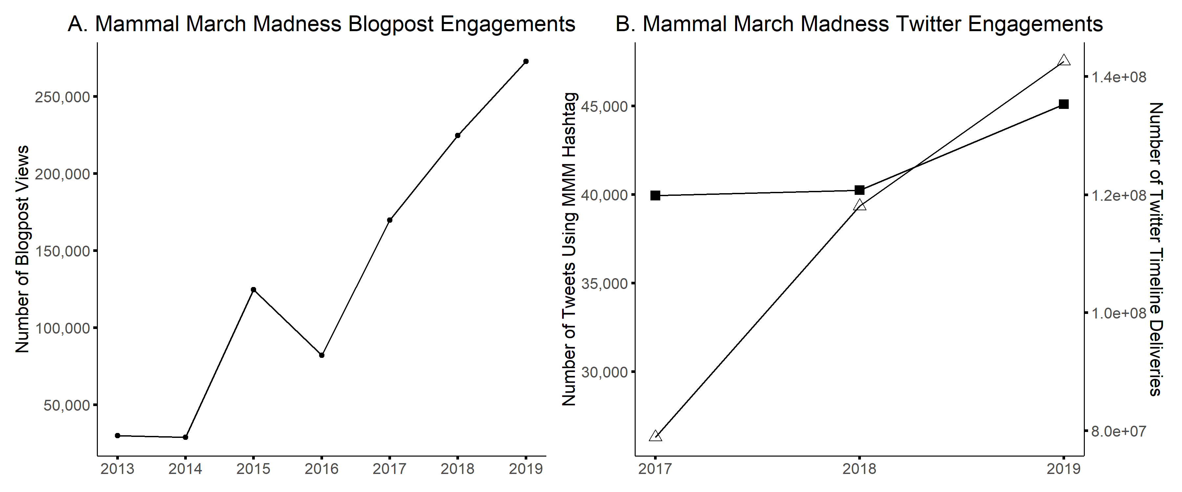
140,000,000
120,000,000
Number of Twitter Timeline Deliveries
100,000,000
Hashtag
Timeline Delivery
80,000,000

Slide 5
